Slide 1
Cyber Security of Wireless & Distributed Systems
CptS 427

Slide 2
Background Knowledge
Cyber security, theory
Cyber security, application
Networking
Wireless Communications
Distributed Systems
Fault Tolerant Systems
Notes:
Only prerequisite Is 327, so we’ll have to spend a fair amount of time laying the groundwork of these topics before we can address the cyber security of them.

Slide 3
Course format
Lots of reading
Lectures (50 min. Monday, Wednesday, Friday)
Questions from reading
Background topics
Current events
Demonstrations on Fridays
Notes:
Course is “front loaded”, so lots of work up front, freeing the month of April for end of semester preparations in all courses.

Slide 4
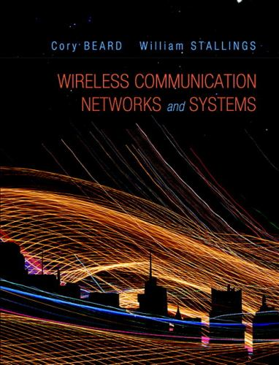
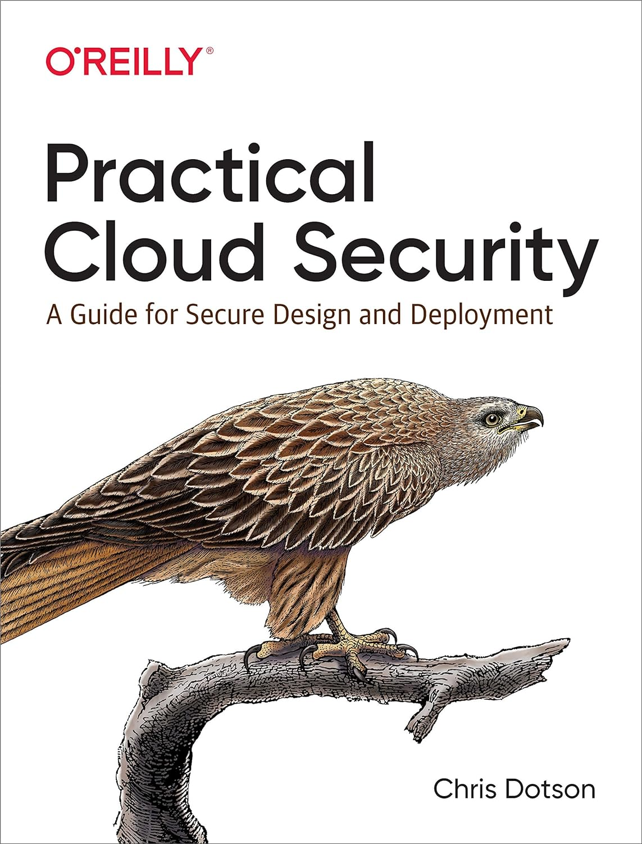
Required Textbooks

Slide 5
Grading
Midterm exam (20%)
Final exam (30%)
Assignments (40%; 10% each month)
Participation (10%)
Notes:
Participation is at the instructor’s discretion. Attendance, classroom discussions, etc.

Slide 6
Expectations
No late work accepted for ANY reason!
Don’t take attendance. Lectures are for you.
Start and end class on time.
Be present.

